Slide 1
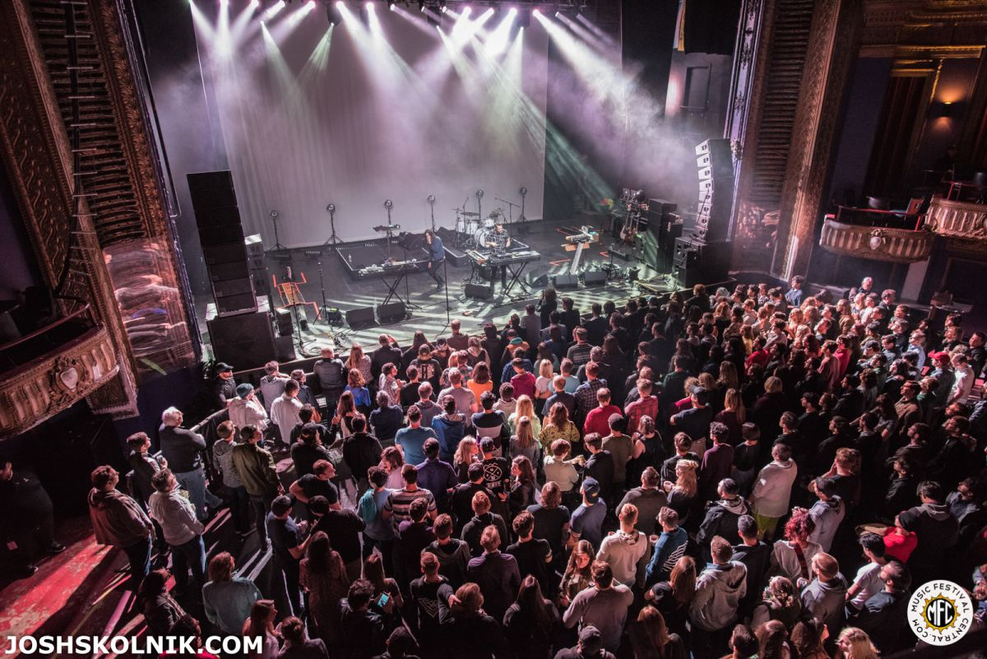

Sell Out Project Informing Concert-Goers
Elliot Gardner
MSiA ‘19
http://18.221.223.30:3000/

Slide 2
Project Motivation
Chicago is a premier destination for musical acts, both big and small
Chicago’s sheer population size means that even small bands can sell out venues
Often people wait to buy tickets while trying to gauge interest from friends
Missing out on a concert during this period is a problem

Slide 3
Project Demo
http://18.221.223.30:3000/

Slide 4
Data
Eventbrite: a website containing information on all sorts of events, including music
API provides:
Events Info: Names, Dates, Costs, Sold Out Status
Venues Info: Names, Locations, Capacity, Age Restrictions
Formats and Categories per Event

Slide 5
Modeling and Success Criteria
Logistic Regression: predicting whether an event will sell out
Linear Regression: predicting how far in advance an event will sell out
Modeling Success: 89% Cross Validation Accuracy for the Logistic Regression, ideally replicate over time with new data
Business Success: Goal of Increased Click Rate on URLs for events which are predicted to sell out

Slide 6
Insights
Of the events that were predicted to sell out by the model (small n):
Majority located in the suburbs
Friday most common day
Venue capacity, listed age restrictions, price did not seem to play a major role

Slide 7
Thank You
Elliot Gardner elliotgardner2019@u.northwestern.edu https://github.com/ElliotGardner/sell_out_project

